Slide 1
Stability of Perovskite Materials using Machine Learning
By ,
Navaneeth P R
B-Tech Engineering Physics , IIT Roorkee
Enrollment no: 19122021

Slide 2
Data Preparation
540 datasets of halide double perovskites were chosen to build the model.
The datasets contained information about the properties of the elements which were present in the double perovskites which were calculated using first principles.
The dataset was taken from this source : dataset_article.
The dataset contained 32 parameters as descriptors for double halide perovskites.
These are used to build a model that predicts the thermodynamic stability based on heat of formation of the perovskite material.

Slide 3
Feature Encoding
In the modelling process , eliminating and reducing the features in an effective way to improve the predictive ability of the model.
Since there are 32 features in the dataset , we try to reduce the dimension of these features into 10 .
Instead of using normal dimensionality reduction techniques like PCA (Principal Component Analysis) which do not account for the non-linear relationships in the dataset , we use a deep learning model called ‘Autoencoders’ to encode these 32 features into 10 features.

Slide 4
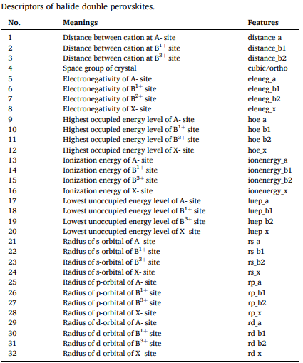

Slide 5
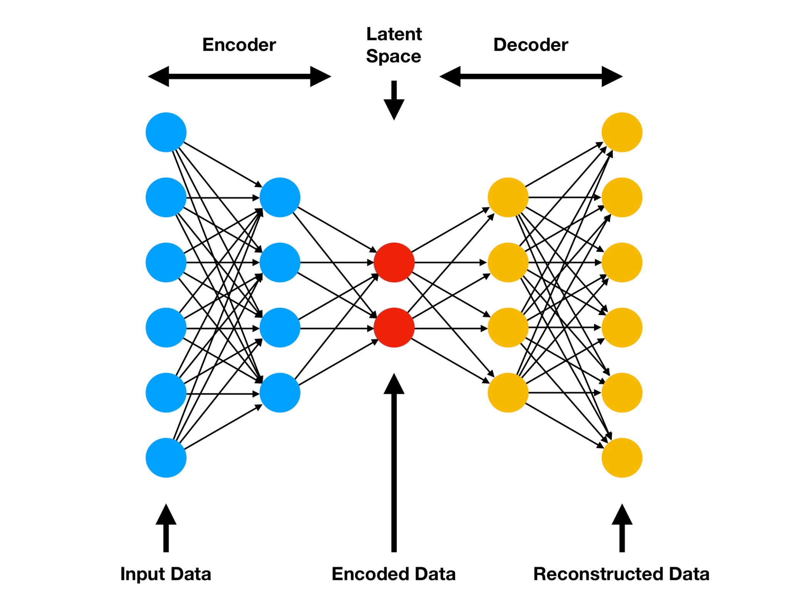
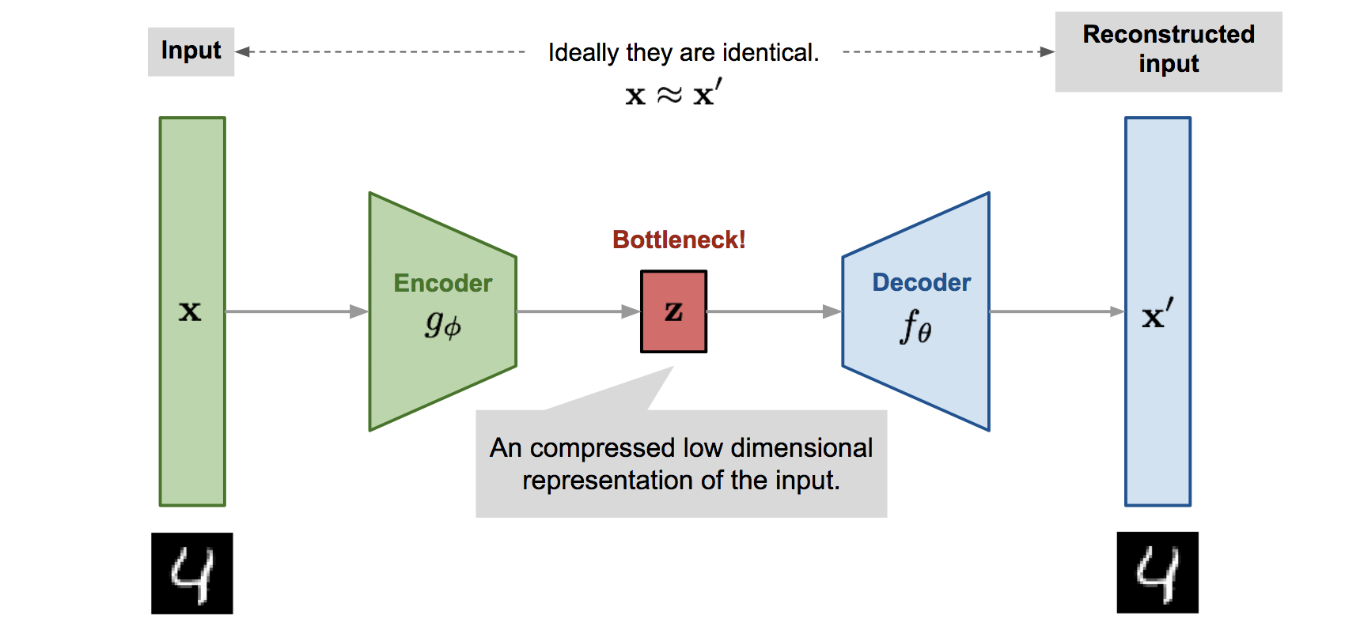
AutoEncoder Neural Networks
Autoencoders are a part of unsupervised deep learning techniques. It takes a set of inputs (X) and passes it through a set of hidden layers and aims to create outputs which are similar to the inputs (X’).

Slide 6
The encoder part of the network encodes the input into a hidden bottle-neck layer and the decoder part uses specific weights and biases to reconstruct those inputs from these hidden layers.
Once the encoder-decoder networks learns to replicate the input (X) in the output (X’) the hidden bottle-neck layer would represent a compressed version of the input (X).
The number of hidden neurons in the bottle-neck layer (here its 10) is smaller than the input layer neurons (32) so the dimension of the feature space also gets reduced to the latent space dimension (10).
Autoencoders can learn more non-linear complex representations in the data compared to PCA, this is the reason for the usage of Autoencoders.

Slide 7
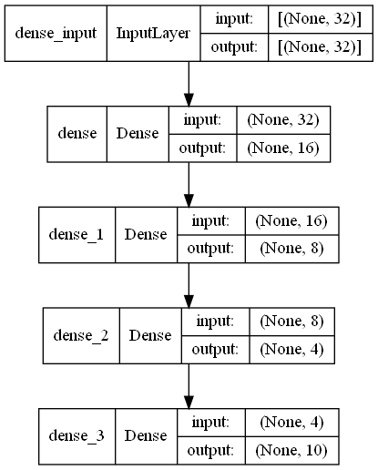
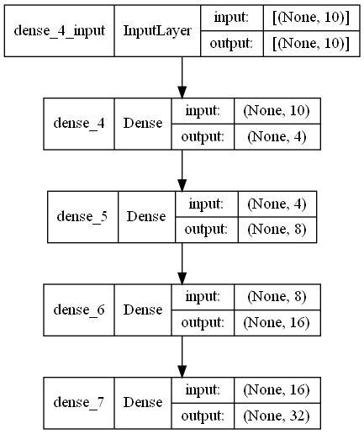
Architecture of Autoencoder used in Feature Encoding
Encoder
Decoder

Slide 8
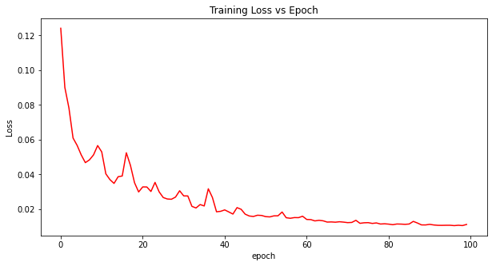
Training of Autoencoder
The autoencoder was trained on the 32 input parameters with about 1.03 % error .
After training the encoder part of the network was used to encode these into just 10 parameters (x1, x2, x3,...x10) which are latent (sparse) representations of the input features.

Slide 9
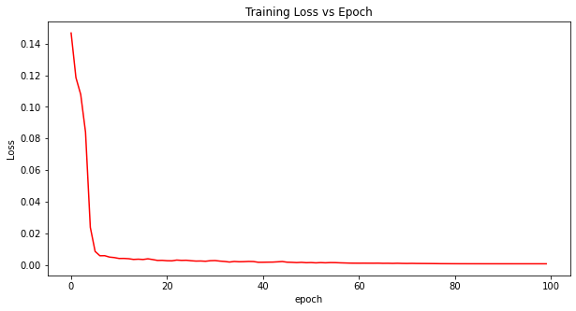
Deep Learning Model for stability prediction
A dense neural network was trained on these encoded features (x1,x2,x3 …x10) with heat of formation( H) as the dependent variable.
The network was trained with final mean squared error to be 0.07 % and an R2 score of 0.987.

Slide 10
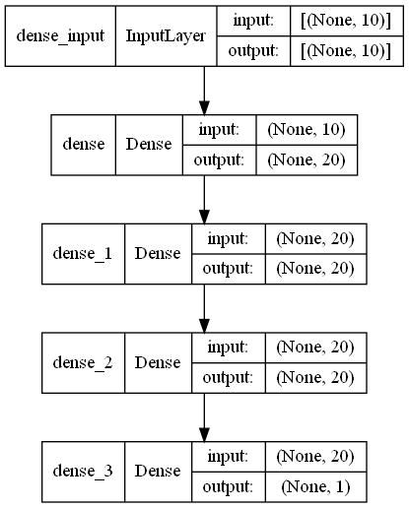
Architecture of the Deep Learning Model

Slide 11
Links of Code and Notebooks
References
Feature Encoder Notebook : Feature Extractor
Deep Learning Model : dl_model
Code and Datasets: Git Repo
Machine learning stability and band gap of lead-free halide double perovskite materials for perovskite solar cells
How To Perform Data Compression Using Autoencoders?

